Slide 1
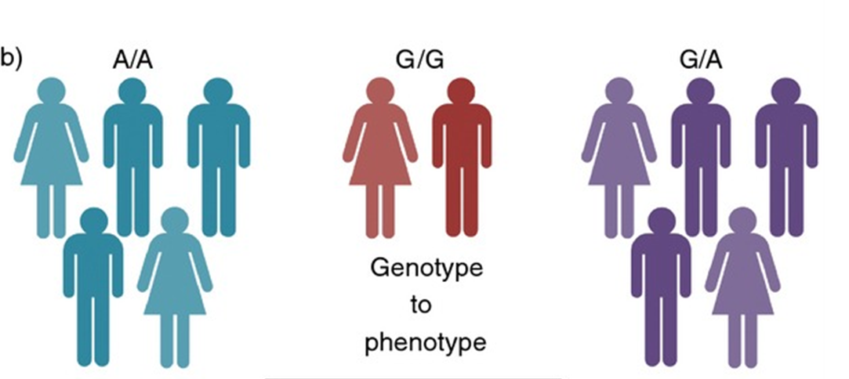
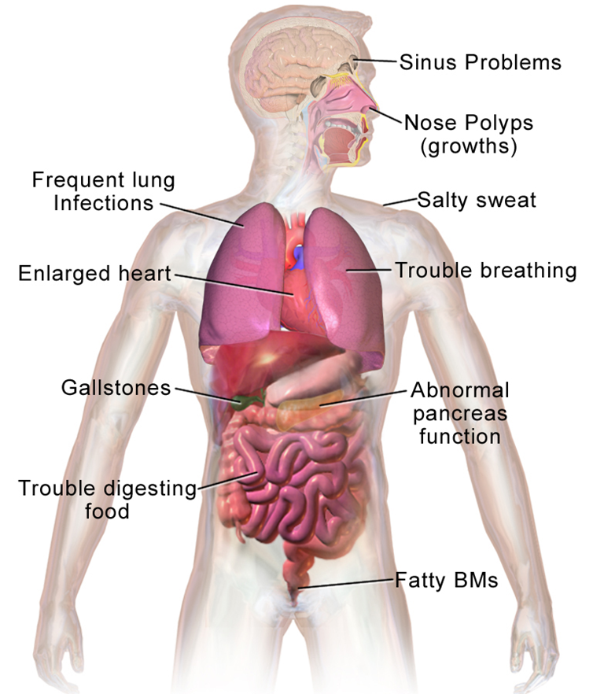
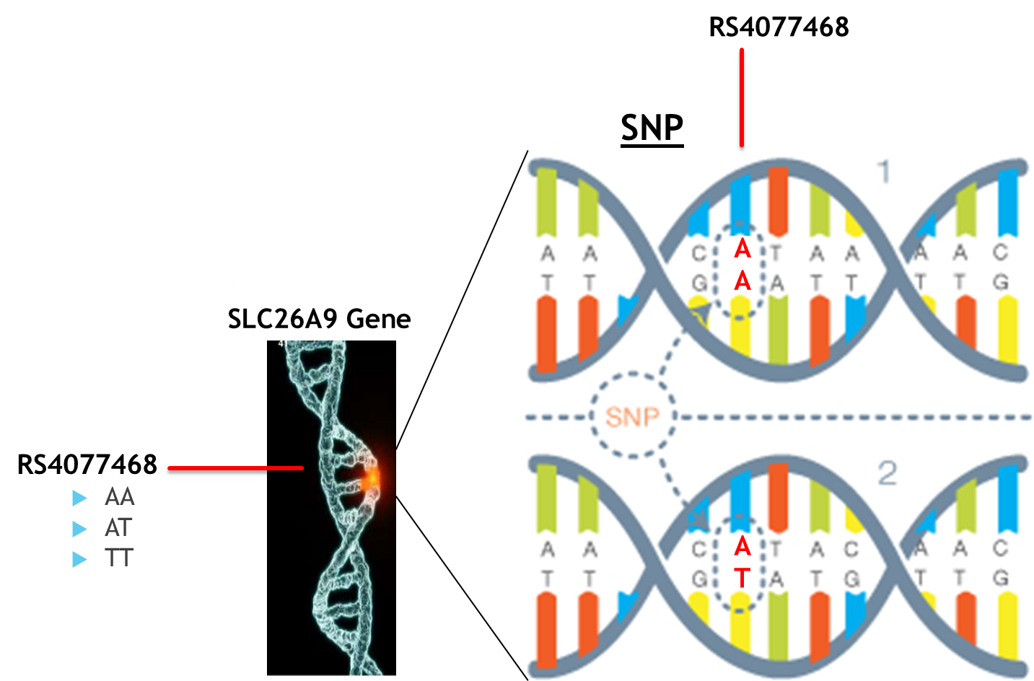
Phenome-Wide Association Study to Determine the Effects of Cystic Fibrosis Modifier Genes in the UK Biobank Population.
Faizan Khalid Mohsin¹, M.Sc; Lisa Strug^{1,2}, Ph.D; Naim Panjwani², M.Sc; and Zeynep Baskurt², Ph.D
¹ Division of Biostatistics, Dalla Lana School of Public Health, University of Toronto, Toronto, ON; ² Hospital for Sick Children, Toronto, ON
α = 0.05
ABSTRACT
2. METHODOLOGY
3. RESULTS
Manhattan Plot for SLC9A3 rs17497684 with Covariates
Question: What is the impact of having the gene variants that increase severity of Cystic Fibrosis disease in people who do not have Cystic Fibrosis?
b)
b)
2.1 STATISTICAL METHOD & SOFTWARE
Manhattan Plot for SLC26A9 rs4077469 with Covariates
What is a PheWAS?
Phenome-Wide Association Study
a)
Esophagitis, GERD and related diseases
OR = 1.064
S.E. = 0.013
P-value = 1.79E-06
Cases = 19,687
Controls = 243,236
Risk Allele is C
Findings: In UKBiobank population
1. People with allele C at SNP rs17497684 of the gene SLC9A3 have 6.4% higher probability of developing Esophagitis, GERD and related disease.
2. Males with allele G at SNP rs5905176 of the gene SLC6A14 were associated with having 68% higher probability of developing Urinary Obstruction.
Bonferroni correction:
α / 1511 = 4.34e-05
Bonferroni correction:
α / 1511 = 4.34e-05
α = 0.05
α = 0.05
Association: genotype (G) → all phenotypes (P’s)
(Variation in the gene)
(Different Physical Traits such as colour blindness or genetic diseases)
Method: Sample size after QC steps ~264,000 unrelated individuals.
Used UKBiobank data (~500,000 individuals). PheWAS method used to find associations.
The data had 1511 phenotypes.
ICD10 data codes from participants’ electronic health recode data was mapped to phenotypes using the PheCode system codes. The phecode mapping was done through collaboration.
Statistical Method: Additive Model for performing PheWAS:
Logit( P(phenotype_i = 1) ) = SLC26A9_i + covariates_i i=1, …, 264,000 individual
0 if RS4077468_AA Phenotype_i = SLC26A9 = 1 if RS4077468_AT
2 if RS4077468_TT
Perform adjusted and unadjusted logistic regression.
Adjusted for covariates: Age, age-squared and sex.
Software:
R ("PheWAS" package from github) and PLINK.
Linux environment for high performance computing.
Manhattan Plot for SLC6A14 rs5905176 with Covariates for Males*
Manhattan Plot for SLC6A14 rs5905176 with Covariates for Females*
1. INTRODUCTION
c)
1.1. CYSTIC FIBROSIS
Fig 1. Issues associated with CF
0 if do not have phenotype i
1 if have phenotype i
Urinary Obstruction
OR = 1.68
S.E. = 0.127
P-value = 4.24E-05 Cases = 64
Controls = 117,334
Risk Allele is G
d)
Cystic fibrosis (CF) is the most common fatal genetic disease affecting Canadian children and young adults.
At present, there is no cure.
Bonferroni correction:
α / 1511 = 4.34e-05
Bonferroni correction:
α / 1511 = 4.34e-05
α = 0.05
α = 0.05
2.2 DATA & QC STEPS
Data:
Approximately 500,000 people aged between 40-69 years in 2006-2010 from across the country (Mainly England, Scotland and Wales).
All participants volunteered to provide their genetic data: Genotype data (100GB): between 500,000 to 1 million SNPs per person.
Individual’s national health records have also been linked with their baseline and genotypic data.
The SNP’s of interest were not genotyped for a high number of individuals (hence were missing). Therefore, instead of imputing them we chose to substitute them with SNP’s that were genotyped and had high pearson correlation (r > 0.7) as identified in section 1.2.
Final data set for SLC9A3, SLC26A9 and SLC6A14 had individuals n= 262,923, 261,655 & 117,398, respectively.
1.2. MODIFIER GENES
The 3 modifier genes of interest and the SNP’s (location of genetic variation) of interest*:
1) SLC26A9 (Chromosome 1 - SNP rs4077468 Substitute SNP: rs4077469; r = 1)
2) SLC6A14 (Chromosome X – SNP rs3788766 Substitute SNP: rs5905176; r = 0.770)
3) SLC9A3 (Chromosome 5 – SNP rs57221529 Substitute SNP: rs17497684; r = 0.821)
*These modifier genes were identified through Sun et al (2012) to be associated with meconium ileum in CF. Here we want to know if they are associated
with other phenotypes in the absence of CF.
4. CONCLUSION
* The analysis for the SLC6A14 rs5905176 SNP was carried out separately for males and females because it is found on the X chromosome.
Quality Control Steps:
Results:
Results suggest there to be an association between SNP rs17497684 of gene SLC9A3 with having Esophagitis, GERD and related diseases.
Every additional C allele increases the odds by about 6.4% of having the related diseases in an individual.
Results generalizable to people with Caucasian ancestry in non-CF populations.
Future Work:
Use curated phenotypes. E.g., Lung function: FEV1/FVC ratio
Include interaction term between allele count and sex.
Instead of using additive model use a genotypic model (treat allele count as categorical variable).
Adjust our analysis for the case control imbalance.
Phenotypic data
(ICD10 data)
N = 349,590
Genotypic data
N = 488,377
1.3. SNP’s
Unrelated Individuals
N = 452,197
Kinship analysis (removed people up to 2nd degree of relatedness)
SNP: Variation at a particular location of a Gene.
Ancestral PCA (removed non-Caucasian individuals)
Caucasians
N = 377,961
Final data
N = 263,607
Merged phenotypic data from ICD10 codes with genotypic data
5. ACKNOWLEDGEMENT:
This research has been conducted using the UK Biobank Resource under Application Number 40946.

